Slide 1

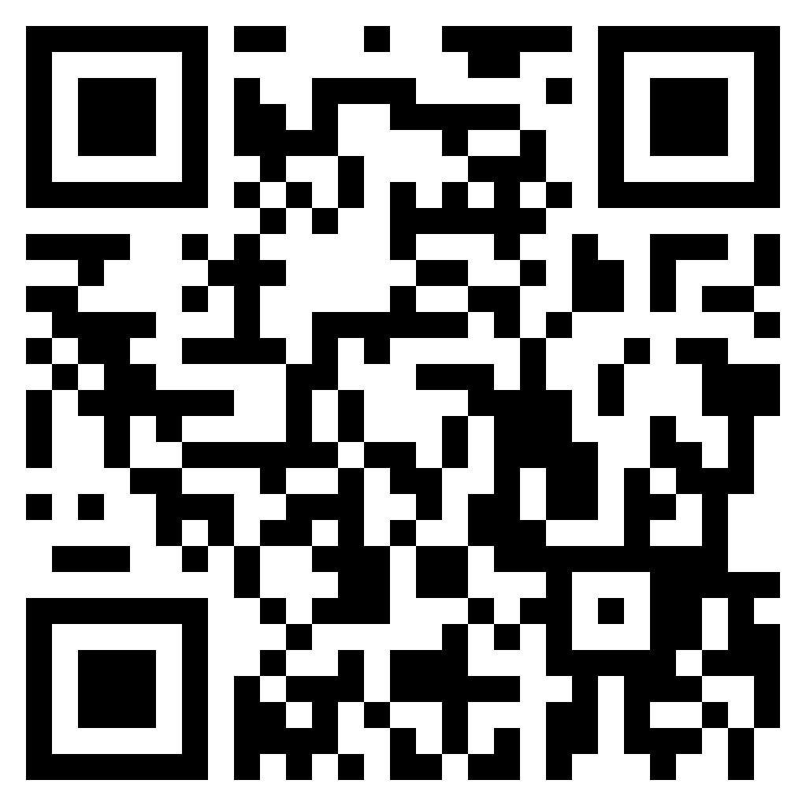
DaBeast Catering LLC
(719) 243-2541
Lunch / Dinner
Cheeseburger ……………………………….…….................... 13
  With bacon/2nd patty ………………………………………....... Add 1.65
Smoked Chicken Sandwich …………….…............................. 13
Beer Brat ………………………………...................................... 11
Meal deal: Chips and drink …………………………..... Add 3.25
Pastelillos ……………………....................................... 6.25
  Stuffed fried empanadas (beef and cheese)
Pincho Fries …....................................................................... 18
  Includes smoked chicken, cheese, guava BBQ, & cilantro
Regular Fries …....................................................................... 9
Desserts
Fried Oreos ……………….. 7
Fried Cheesecake Bites …. 8
Limber De Coco (Ice Cream)
………………………………. 6
Beverages
Guanabana ………………. 6
  Creamy tart drink derived from indigenous fruit ☺
Soft Drinks …………………. 3
  Gatorade, Red Bull, Coke,
  Sprite, Fanta, Iced Tea, etc.
Water ……………………….. 3
Customer is responsible for any allergen disclosures.
Listed prices are the cash price.
https://dabeastservices.com

